Slide 1



TEAM MEMBERS : HEMASEN S - 211423104223
JANAVI SREE R – 211423104238 GUIDE DETAILS : Dr.T.JACKULIN M.E., Ph.D.,

Slide 2
Title of the Project work
Title : Cyberbullying Detection in Educational Platforms Using Behavioural-Based Machine Learning

Slide 3
AGENDA
Introduce the issue of cyberbullying in online educational platforms.
Describe the proposed hybrid detection framework and its components.
Demonstrate the system’s workflow, implementation, and interface.
Summarize the results, insights, and potential future improvements.

Slide 4
INTRODUCTION
Core Challenge: Subtle and hidden forms of online harassment often escape traditional detection methods.
Proposed Solution: A Hybrid Detection Framework combining Deep Learning (RoBERTa, BiLSTM) and ML models (SVM, Random Forest, Logistic Regression).
Key Innovation: Integrates behavioral indicators (login patterns, message frequency, CAPS use) with a real-time ngrok interface for admin monitoring and intervention.
Digital Learning & Risks: Online educational platforms enhance flexibility but also expose students to cyberbullying threats.

Slide 5
Objectives of the Project work
To detect cyberbullying using behavior and content patterns.
To automate abuse detection and reduce manual checks.
To alert admins early and ensure student safety.
To build a lightweight prototype for easy school integration .

Slide 6
LITERATURE SURVEY
S.No | Title/Publications | Techniques adopted | Results | Conclusions/Limitations
01. | Cyberbullying Detection on Social Media Using Stacking Ensemble IEEE TRANSACTIONS ON SOCIAL NETWORKS & INFORMATION, VOL. 14, NO. 8, AUGUST 2023 | Word2Vec embeddings CNN, BiLSTM, Conv1D Stacking ensemble model | 96.64% accuracy on Twitter High precision and recall (>95%) Ensemble improved performance by ~4% | Only message-level classification Cannot detect roles or session behavior No real-time adaptability

Slide 7
LITERATURE SURVEY (contd ...)
S.No | Title/Publications | Techniques adopted | Results | Conclusions/Limitations
02. | Hybrid DeBERTa+ Gated Broad Learning System IEEE TRANSACTIONS ON ARTIFICIAL INTELLIGENCE, VOL. 31, NO. 6, JUNE 2025 | DeBERTa transformer Squeeze-and-Excitation (SE) blocks Gated Broad Learning System (GBLS) | Accuracy: 91–95% across multiple datasets Robust across varied social media text | Excellent for sentence semantics No modeling of user roles or behavioral flow Needs context-rich data to adapt for education

Slide 8
LITERATURE SURVEY (contd ...)
S.No | Title/Publications | Techniques adopted | Results | Conclusions/Limitations
03. | Bias Evaluation in Cyberbullying Detection Models IEEE TRANSACTIONS ON FAIRNESS IN AI, VOL. 28, NO. 12, DECEMBER 2024 | Cross-platform F1-score testing Demographic fairness metrics Analysis on multiple platforms | F1-score dropped 20–30% on unseen datasets BERT models had best cross-domain results | Biased datasets cause poor generalization Diverse, inclusive data needed for educational use Requires fairness-aware training

Slide 9
LITERATURE SURVEY (contd ...)
S.No | Title/Publications | Techniques adopted | Results | Conclusions/Limitations
04. | CONCISE: Continuous Session-Based Detection Framework IEEE TRANSACTIONS ON WEB INTELLIGENCE, VOL. 22, NO. 4, APRIL 2020 | Sliding window of recent messages Repetition and toxicity tracking Session-aware alert system | Reduced false positives by 40% Detected 75% of bullying sessions early | Needs multiple messages for accuracy Slow for immediate alerts Ideal for LMS chat logs

Slide 10
LITERATURE SURVEY (contd ...)
S.No | Title/Publications | Techniques adopted | Results | Conclusions/Limitations
05. | Role-Based Cyberbullying Detection in Student Forums IEEE TRANSACTIONS ON EDUCATIONAL DATA MINING, VOL. 13, NO. 1, JANUARY 2024 | Role-tagging (bully, victim, bystander) Repetition and toxicity tracking Session-aware alert system | F1 improved by 10% using role-aware models Bully/victim accuracy >85% | Needs manual role labeling Peer data not available in all systems Scalability issue in anonymous platforms

Slide 11
LITERATURE SURVEY (contd ...)
S.No | Title/Publications | Techniques adopted | Results | Conclusions/Limitations
06. | Role-Based Cyberbullying Detection in Student Forums IEEE TRANSACTIONS ON EDUCATIONAL DATA MINING, VOL. 13, NO. 1, JANUARY 2024 | Role tagging: bully, victim, bystander Behavioural feature extraction (reply count, toxicity) Conversation graph for peer interaction Role-aware classifiers (e.g., SVM, Random Forest) | Improved F1-score by 10% over standard classifiers Higher accuracy in detecting bully and victim roles Better prediction of conversation flow and peer dynamics | Requires manually labeled role datasets Not suitable for anonymous or fast-chat environments Depends on structured conversation data (like forums or LMS threads)

Slide 12
LITERATURE SURVEY (contd ...)
S.No | Title/Publications | Techniques adopted | Results | Conclusions/Limitations
07. | Cyberbullying Detection via Temporal Attention in Educational Chats IEEE TRANSACTIONS ON LEARNING TECHNOLOGIES, VOL. 16, NO. 2, APRIL 2024 | Temporal Attention-based BiLSTM Sentiment trajectory modelling Role-specific word patterns | 90.8% accuracy on annotated LMS chat logs Detected bullying within 4-message windows | Requires sequential message flow Less effective in isolated message detection Moderate GPU requirement

Slide 13
LITERATURE SURVEY (contd ...)
S.No | Title/Publications | Techniques adopted | Results | Conclusions/Limitations
08. | GCN-Based Detection of Peer Abuse in Academic Forums IEEE TRANSACTIONS ON COMPUTATIONAL SOCIAL SYSTEMS, VOL. 10, NO. 1, JAN 2025 | Graph Convolutional Networks (GCNs) Peer interaction graph modelling Toxic reply clustering | 86.7% F1-score across 3 academic platforms Detected indirect peer abuse through interaction flow | Relies on well-threaded forum structures Low performance in private messages Requires conversation metadata

Slide 14
LITERATURE SURVEY (contd ...)
S.No | Title/Publications | Techniques adopted | Results | Conclusions/Limitations
09. | Lightweight NLP for Cyberbullying Detection in School Devices IEEE INTERNET OF THINGS JOURNAL, VOL. 9, NO. 10, OCT 2024 | TinyBERT on edge devices Lexicon-enhanced message filtering On-device LSTM classifier | 83.2% accuracy on school app Alert generation within 1.5s | Limited vocabulary understanding Can't handle complex sarcasm Ideal only for short texts

Slide 15
LITERATURE SURVEY (contd ...)
S.No | Title/Publications | Techniques adopted | Results | Conclusions/Limitations
10. | Emotion-Augmented Detection of Aggressive Behavior in E-Learning IEEE TRANSACTIONS ON AFFECTIVE COMPUTING, VOL. 14, NO. 1, JAN 2025 | Emotion tagging (fear, anger) CNN-BiLSTM with emotion fusion layer Polarity + toxicity signal mixing | 92.1% accuracy on EduChat dataset Better handling of sarcasm and indirect bullying | Emotion labels not always accurate Overlap between joke and insult detection Needs emotion classifier tuning

Slide 16
Problem Statement (WHY?)
Cyberbullying is rising on educational platforms like LMS, forums and chat systems.
Harmful messages often bypass current moderation systems.
Affected students face emotional distress, academic decline, and isolation.
Especially impacts students in virtual and hybrid learning environments.
Aligned with SDG 3 (Well-being), SDG 4 (Quality Education), and SDG 16 (Peace & Justice).

Slide 17
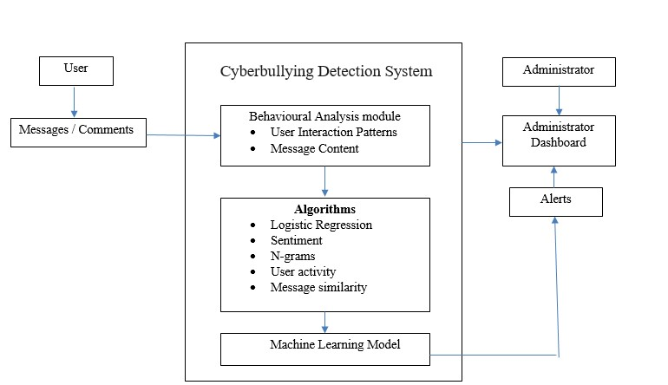
Architecture diagram

Slide 18
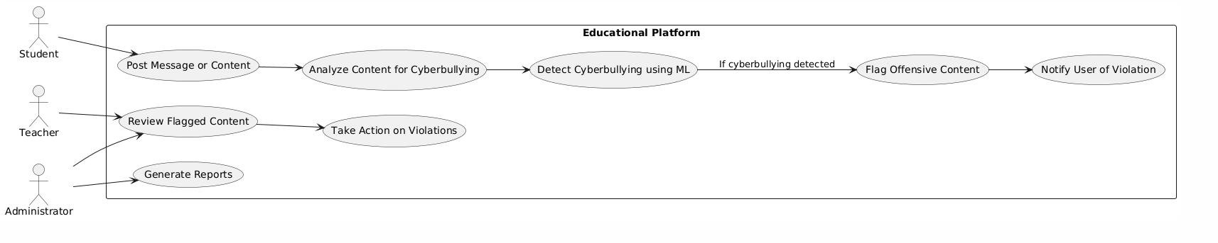
Use case diagram

Slide 19
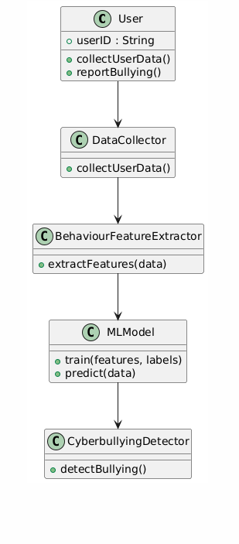
Class diagram

Slide 20
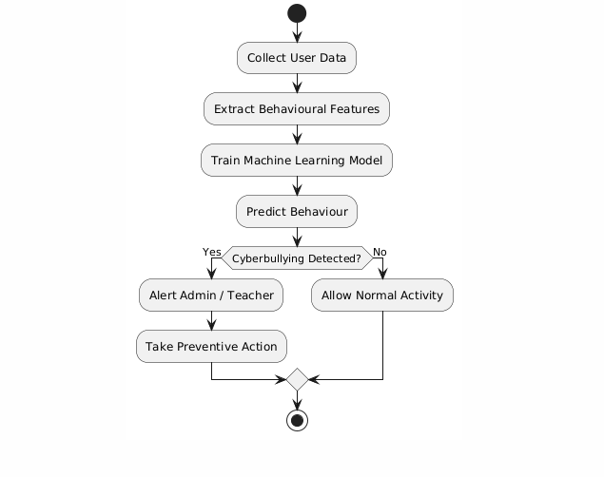
Activity diagram

Slide 21
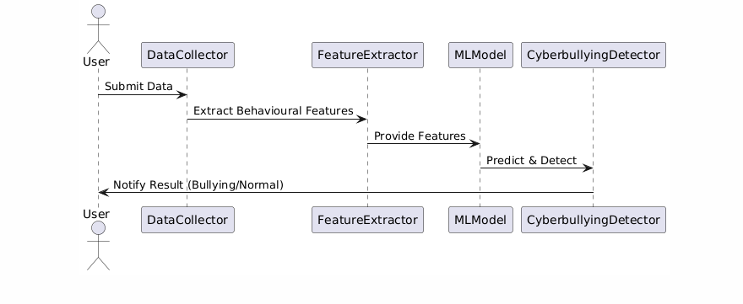
Sequence diagram

Slide 22
Collaboration diagram

Slide 23
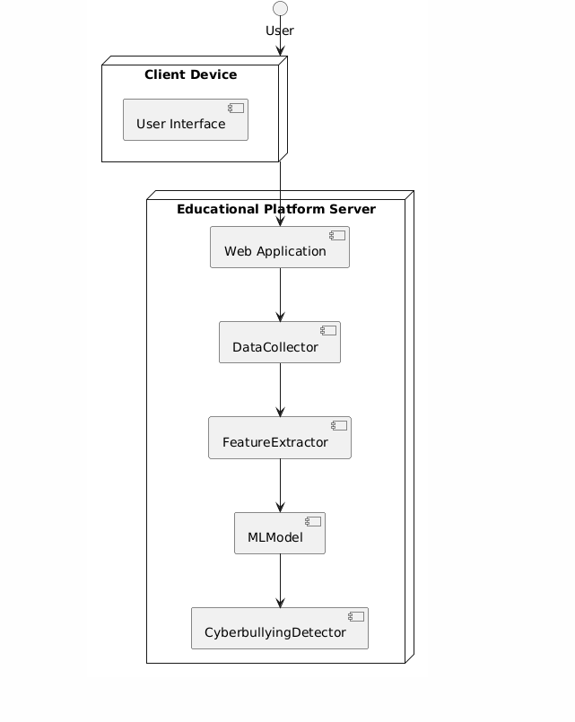
Deployment diagram

Slide 24
Modules
Module 1: Data Collection & Preprocessing
Objective: Gather real-world educational platform/chat datasets and prepare clean data for analysis.
Module 2: Behavioral Feature Extraction
Objective: Identify behavioral patterns that indicate cyberbullying beyond text content. Module 3: Machine Learning Model Training
Objective: Train and validate ML/DL models to classify cyberbullying behaviour Module 4: Cyberbullying Detection
Objective: Detect cyberbullying in real-time from student interactions.
Module 5: Alert & Reporting
Objective: Notify teachers/admins and provide insights on bullying activities.

Slide 25
Topics and Algorithms Used
Text Preprocessing: Tokenization, TF-IDF
Features:
1. Behavioral: CAPS usage, time bursts, post density
2. Content: Toxic words, sentiment
ML Algorithms:
1. Logistic Regression, Random Forest, SVM
2. RoBERTa (Transformer), BiLSTM
Handling Imbalance: SMOTE
Evaluation: Precision, Recall, F1-Score

Slide 26
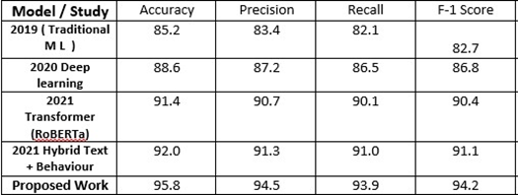
PERFORMANCE ANALYSIS

Slide 27
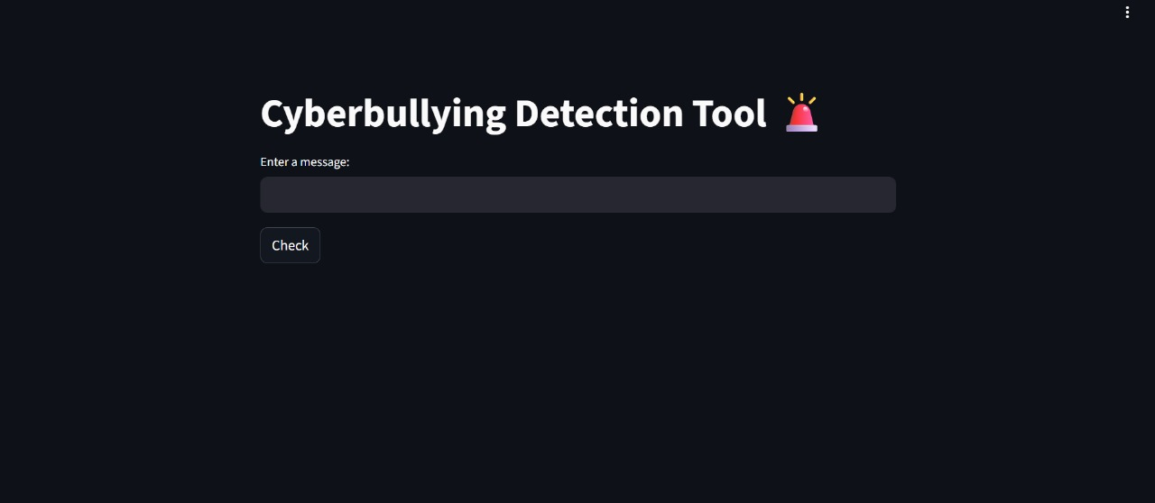
IMPLEMENTATION
LINK INTERFACE

Slide 28
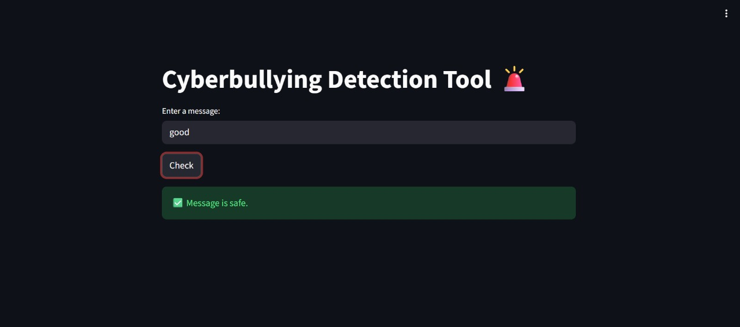
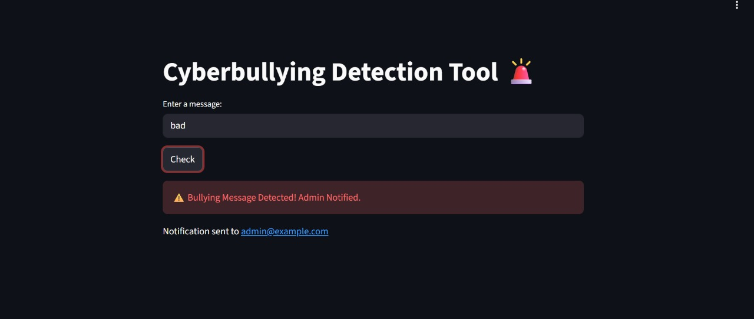
CONCLUSION
Result

Slide 29
FUTURE WORK
Enhance contextual understanding of messages and user behavior for higher detection accuracy.
Use larger, more diverse datasets to improve model generalization and reliability.
Integrate advanced NLP models like transformers with behavior-based features.
Develop real-time, adaptive detection systems to ensure safer online learning environments.

Slide 30
References
[1] IEEE TRANSACTIONS ON AFFECTIVE COMPUTING, VOL. 14, NO. 1, JAN 2025
[2]. IEEE TRANSACTIONS ON ARTIFICIAL INTELLIGENCE, VOL. 31, NO. 6, JUNE 2025
[3] IEEE TRANSACTIONS ON FAIRNESS IN AI, VOL. 28, NO. 12, DECEMBER 2024
[4] IEEE TRANSACTIONS ON WEB INTELLIGENCE, VOL. 22, NO. 4, APRIL 2020
[5]. IEEE TRANSACTIONS ON EDUCATIONAL DATA MINING, VOL. 13, NO. 1, JANUARY 2024 [6]. IEEE TRANSACTIONS ON EDUCATIONAL DATA MINING, VOL. 13, NO. 1, JANUARY 2024
[7]. IEEE TRANSACTIONS ON LEARNING TECHNOLOGIES, VOL. 16, NO. 2, APRIL 2024
[8]. IEEE TRANSACTIONS ON COMPUTATIONAL SOCIAL SYSTEMS, VOL. 10, NO. 1, JAN 2025
[9]. IEEE INTERNET OF THINGS JOURNAL, VOL. 9, NO. 10, OCT 2024
. [10]. IEEE TRANSACTIONS ON SOCIAL NETWORKS & INFORMATION, VOL. 14, NO. 8, AUGUST 2023

